Slide 1
Catchment Catalyst
Current dashboard:
https://www.northdevonbiosphere.org.uk/north-devon-waterbody-dashboard.html

Slide 2
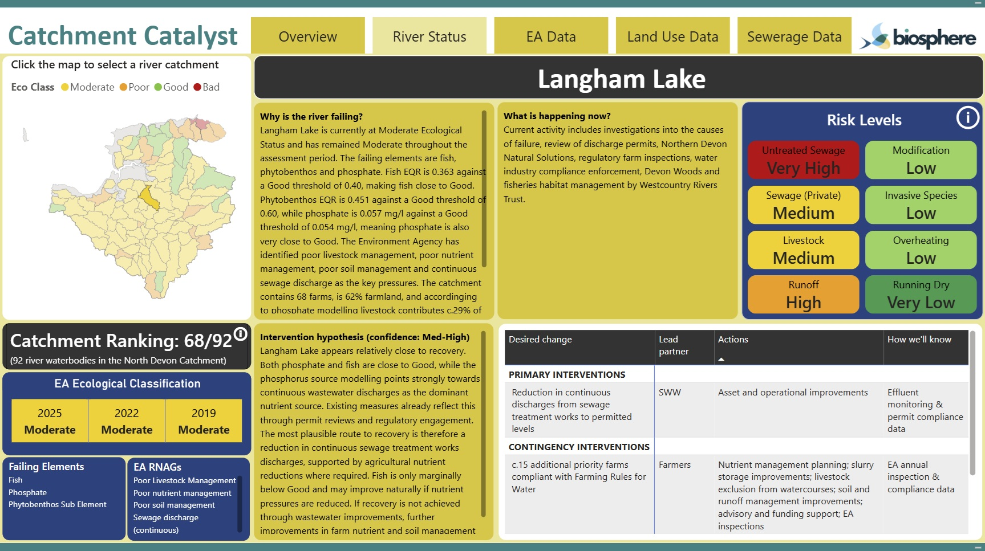
Central database with one table for each parameter
Each row has a Catchment ID
EA Water Quality Scores
Habitat and Land Use
Catchment ID | Measure | Year | Result
GB108050008080 | Ecological | 2025 | Poor
GB108050008080 | Fish (EQR) | 2025 | 0.16
GB108050008080 | Phosphate | 2025 | 0.013
GB108050008100 | Ecological | 2025 | Good
GB108050008100 | Fish (EQR) | 2025 | 0.48
GB108050008100 | Phosphate | 2025 | 0.008
GB108050014460 | Ecological | 2022 | Moderate
GB108050014460 | Fish (EQR) | 2022 | 0.36
GB108050014460 | Phosphate | 2022 | 0.057
GB108050020040 | Ecological | 2022 | Poor
… | … | … | …
Catchment ID | Habitat | Area (ha)
GB108050008080 | Farmland | 612
GB108050008080 | Woodland | 388
GB108050008080 | Not farmed | 1,240
GB108050008100 | Farmland | 905
GB108050008100 | Woodland | 310
GB108050014460 | Farmland | 1,711
GB108050014460 | Not farmed | 423
GB108050014460 | Woodland | 439
GB108050014460 | Urban | 91
GB108050020040 | Farmland | 1,960
… | … | …
Frontend (can do this as many times as needed)
1) User inputs catchments to include:
Catchment ID
GB108050008080
GB108050008100
GB108050014460
…
2) Publish
3) Publish exactly the same frontend for the user given catchments, with a different url:
Why is the river failing
…
etc. one table per parameter
Catchment ID | Description
GB108050008080 | Wooleigh Brook is currently at Moderate Ecological Status. The principle failing element is …
GB108050008100 | Mole (Taw to Bray) is currently …
… | …
+
Store GeoJSON or Shapefiles for all catchments

Slide 3
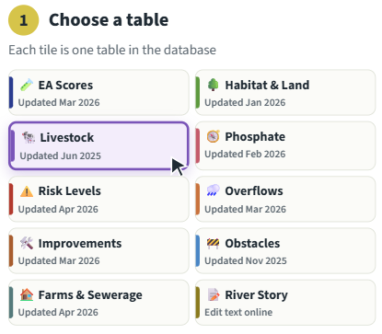
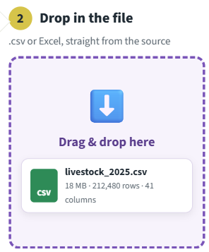
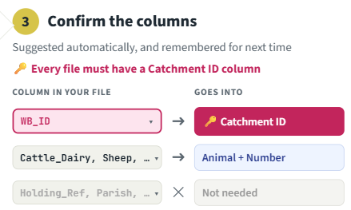
Getting the data into the central database
Varying levels of automation
Make Excel tables look exactly the same as central database tables
Gradually automate parts that take the most time
  i.e. Central database table created by dropping in two unformatted Excel files
Full automation
  User input new catchment list to include, automated script calls APIs and pulls all data into the Central database
Pros:
Scalable: can automate more (step 2) as sell more locations
Cons:
Doesn’t save much time at the moment
Biosphere has less control on what the dashboard looks like / doing upgrades, takes time to tell IGI what to do

